Slide 1

Retail Sales Analytics

Slide 2

Introduction
This project focuses on performing comprehensive retail sales analytics by leveraging a combination of powerful data tools and techniques. The primary objective is to extract meaningful insights from retail sales data to understand customer behavior, identify sales trends, optimize inventory, and ultimately drive business growth.

Slide 3
Business Use Cases
To Analyse sales performance across different stores and staff.
Identify high-value customers and buying behaviour patterns.
Perform customer segmentation for targeted marketing.
Monitor inventory levels and product performance.
Create an interactive Power BI dashboard for management insights.

Slide 4
Excel – Data Cleaning & Preparation
Standardize Column Headers
Standardize Column Headers means renaming all column names into a consistent format.
All the column headers have been updated in snake _ case format for all the datasets across sheets.
2. Remove Duplicates
Remove Duplicates means eliminating repeated rows or values from a dataset so that each record appears only once.
No duplicate records found in the entire dataset which has been verified through the conditional formatting.
3. Handle Missing Values
Handle Missing Values means dealing with blank or null data in a dataset.
Null values found in multiple datasets where as manager_id is missing for one staff, shipped_date is missing for few orders and phone numbers are missing for few customers and replaced all the null values with NA.

Slide 5
4. Data Type Conversion
All the date column datatypes have been converted to the standard excel date format.
Numerical fields like quantity, price are updated in the number format. Like wise, text formats have been also updated.
5. Data Validation
Data Validation is the process of setting rules in Excel to control what type of data can be entered into a cell.
Dropdown for order_status has been created using data validation list method to ensure consistency with the options (Delivered, Shipped, Processing, Packed).
6. Create New Derived Columns
Create New Derived Columns means adding extra columns to a dataset by applying formulas or calculations on existing data.
using the below-mentioned formula.
Total_price = (list_price * quantity) / discount

Slide 6
7. Merge Lookup Data
Using VLOOKUP to pull the product_name from the Products table into the Order_Items sheet based on product_id.
8. Create Basic Pivot Table
Pivot Table means summarizing the total sales by each category.
Building a pivot table to show total price by product category has been added to values by setting the value field settings to sum to get the total_price of each category.
9. Sort and Filter for Outliers
Sorting list_price column to find products with very high or very low prices that might indicate special cases.
10.Prepare Final CSVs
All the cleaned datasets have been saved in a separate sheets in CSV format to import in SQL.
Created one separate excel file and updated all the datasets in the same file in different spread sheets along with the tasks.

Slide 7

SQL – Database Management and Querying

Slide 8
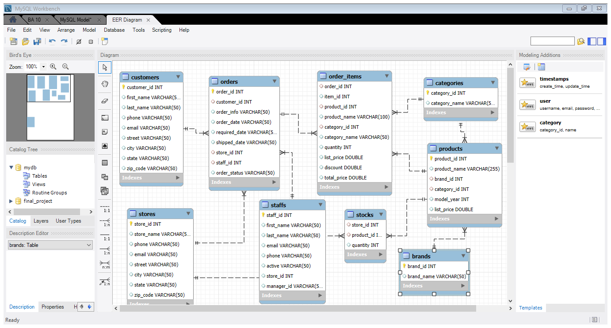
SQL – Database Management and Querying
1. Create Tables Based on ERD
Created different tables based on the ER diagram in the MySQL workbench by importing the datasets through table data import wizard.
Unique, primary and foreign keys have been assigned to the columns as required to manage relationships between the tables.
Datatypes have been updated for each column. Stores details about each customer. Customer_id uniquely identifies every customer.

Slide 9
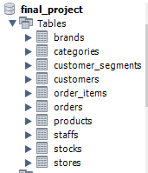
2. Import CSVs into SQL
Created the database in the name of final_project.
In the Navigator panel, right-click the table you want to import into and select Table Data Import Wizard.
Datatypes of each columns in the tables have been updated as per the standard format.

Slide 10
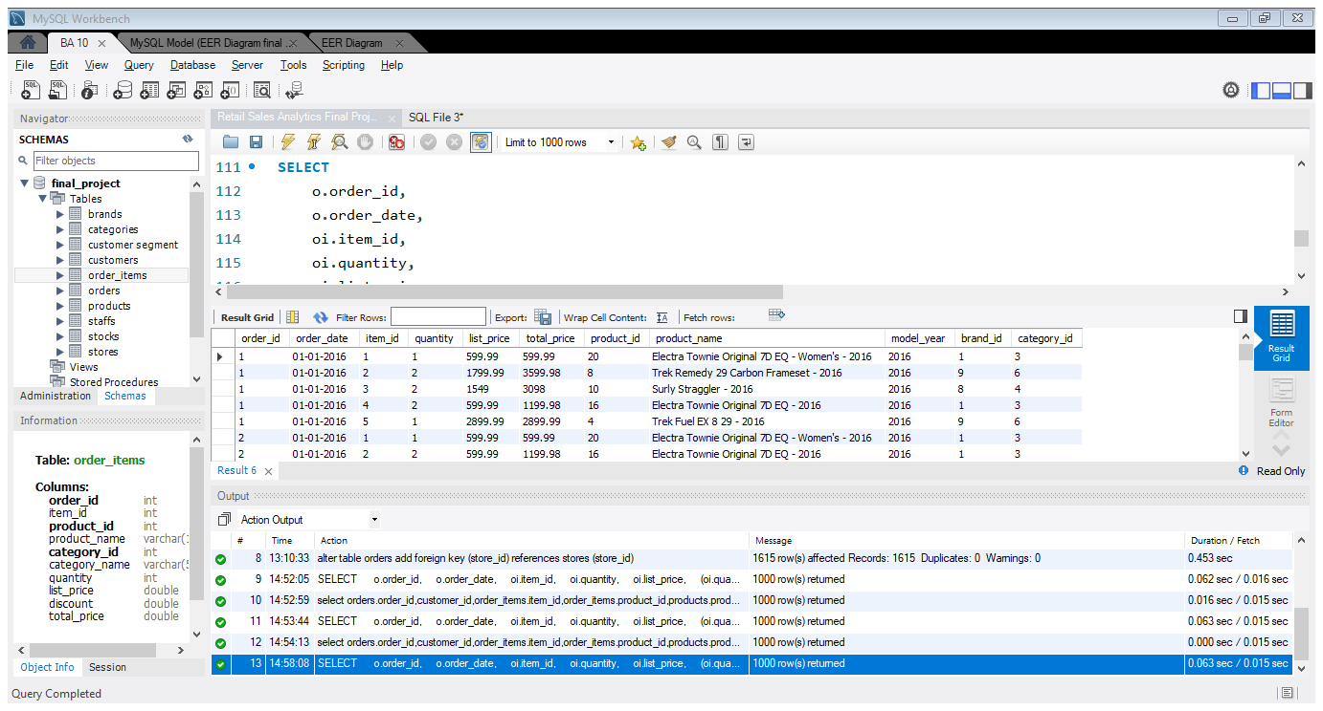
3. Inner Join for Order Details
INNER JOIN statement joins two tables based on a common column and selects rows that have matching values in these columns.
Using order_id, joined orders and order_items tables where as products and order_items tables have been joined using product_id.

Slide 11
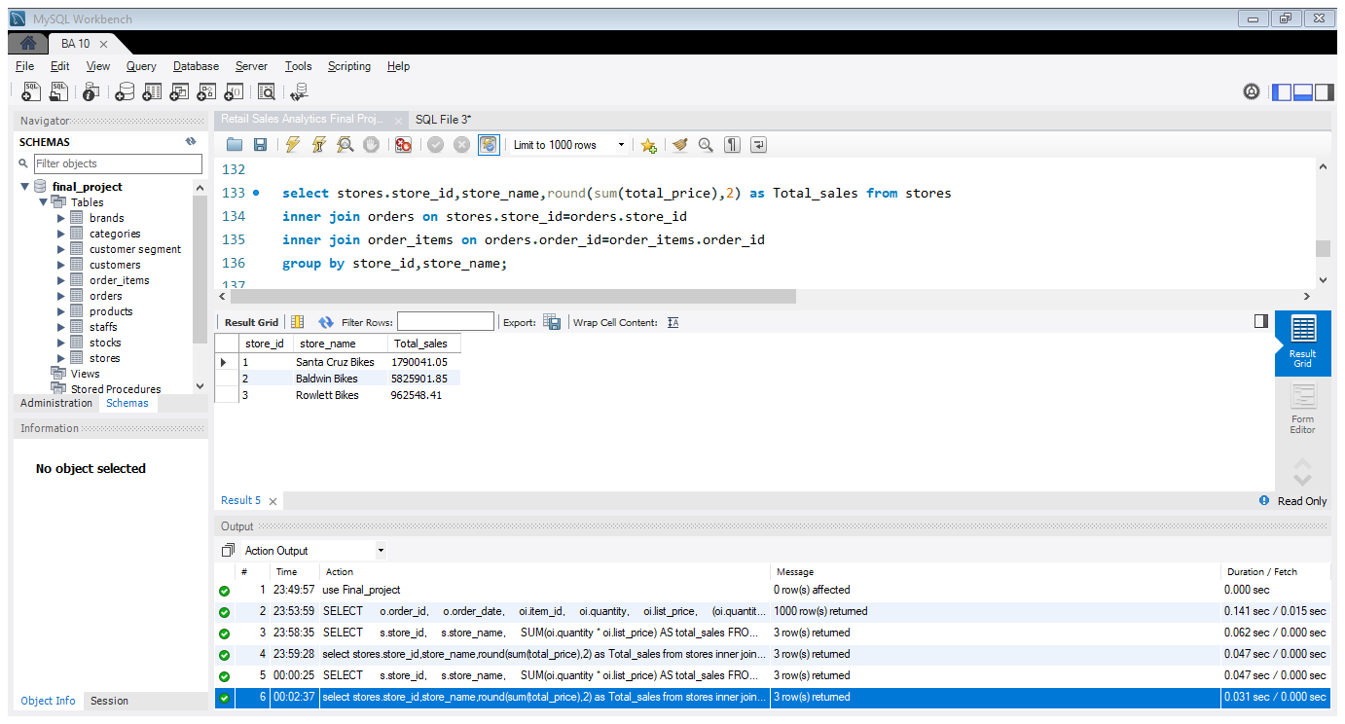
4. Total Sales by Store
Santa Cruz Bikes has the highest sales (~17.9M).
Baldwin Bikes follows with ~5.8M.
Rowlett Bikes has the lowest sales (~962K).

Slide 12
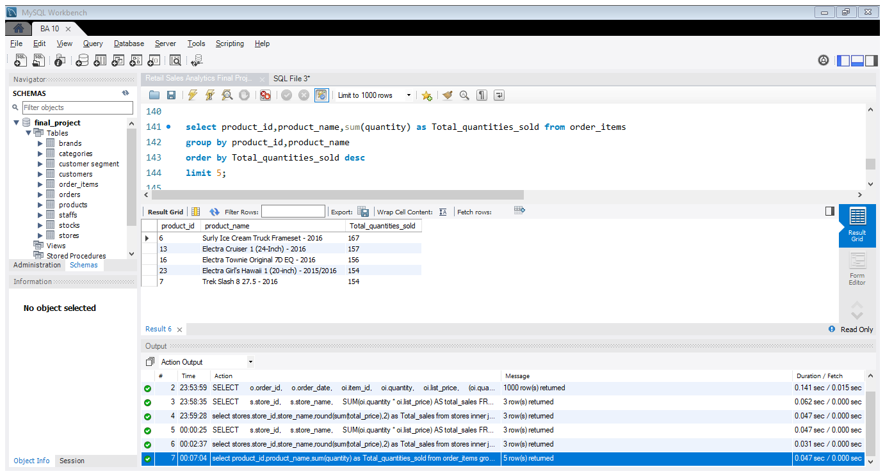
5. Top 5 Selling Products
Best Selling Product:
Surly Ice Cream Truck Frameset - 2016 with 167 units sold.
Electra Brand Dominance:
Out of the top 5, 3 products are from Electra (Cruiser, Townie, Hawaii), showing its popularity.
Close Competition:
Products ranked 2nd to 5th have very close sales (154–157 units).
Trek Slash 8 is also a strong competitor in sales.

Slide 13
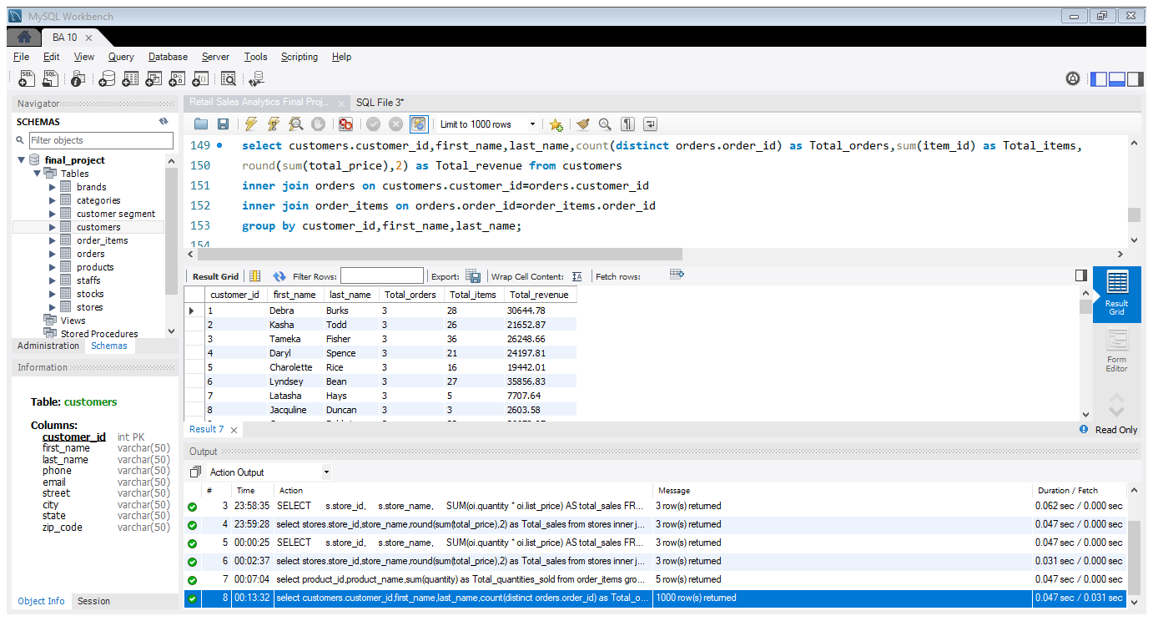
6. Customer Purchase Summary
For each customer, retrieved the total orders placed, total items purchased and total revenue.
There are 1445 customers overall where as maximum orders placed by single customer is 3 where as maximum items purchased is 36 and the highest revenue provided is 37800/-.
This has been performed using inner join and group by methods.

Slide 14
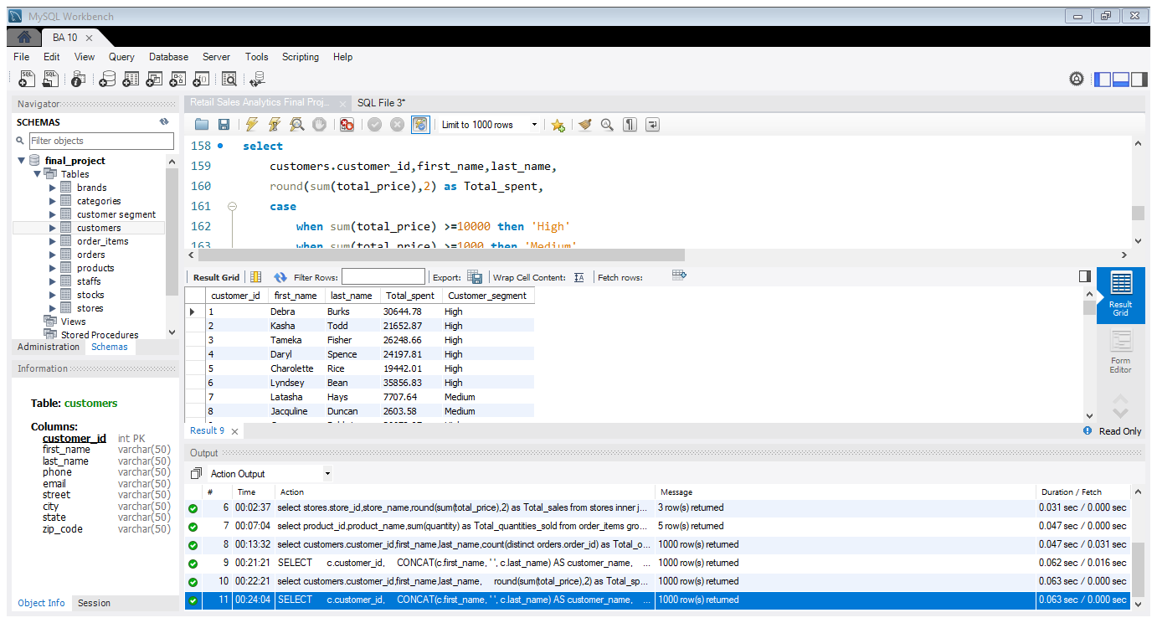
7. Segment Customers by Total Spend
High-value Customers contribute the majority of revenue. They should be targeted for loyalty programs, premium offers, and personalized promotions.
Customers have been classified in to 3 different categories based on the amount spent.
The customers spent above 10000 has been classified as high where as customers spent between 1000 to 9999 has been classified as medium.
Remaining customers spent below 1000 are classified as low.

Slide 15
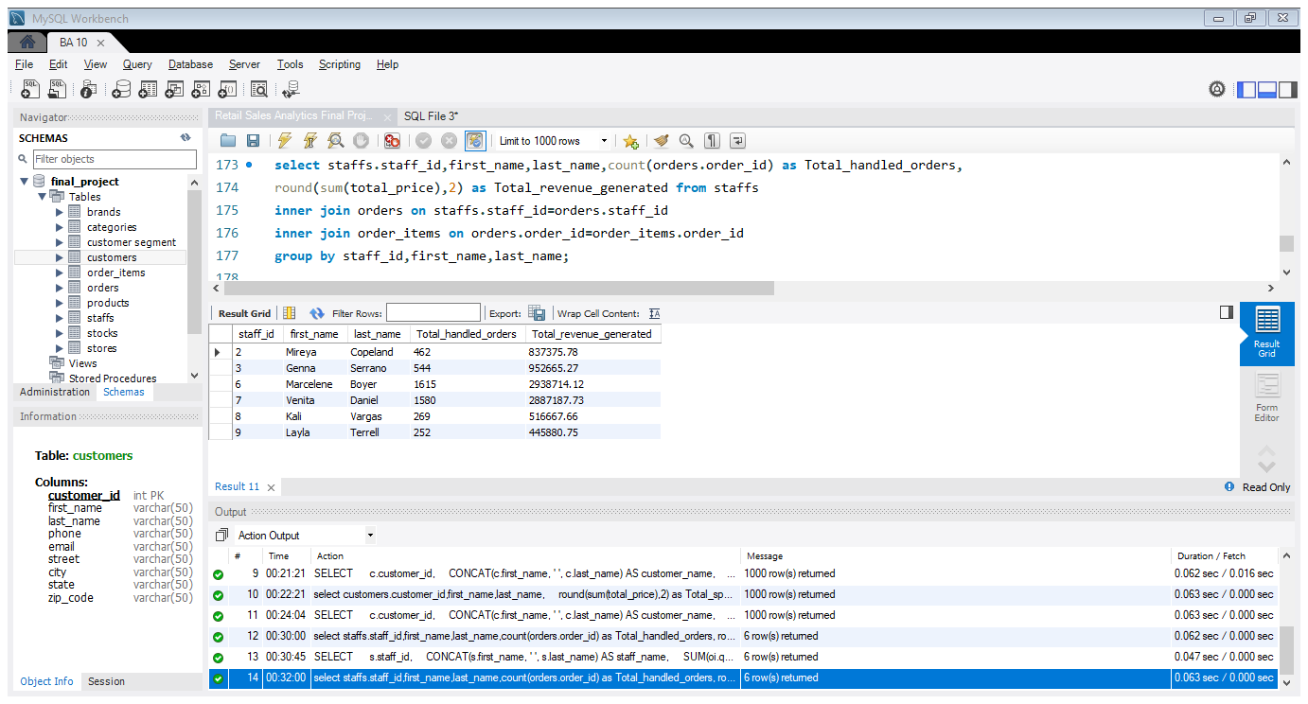
8. Staff Performance Analysis
🔎 Insights
Top Performers:
Staff (ID 6) and (ID 7) are leading with 1,600+ orders each and generating nearly ₹2.9M revenue each.
Low Performers:
Staff (ID 8) and (ID 9) handled the fewest orders (< 270) and generated the lowest revenue (< ₹520k).

Slide 16
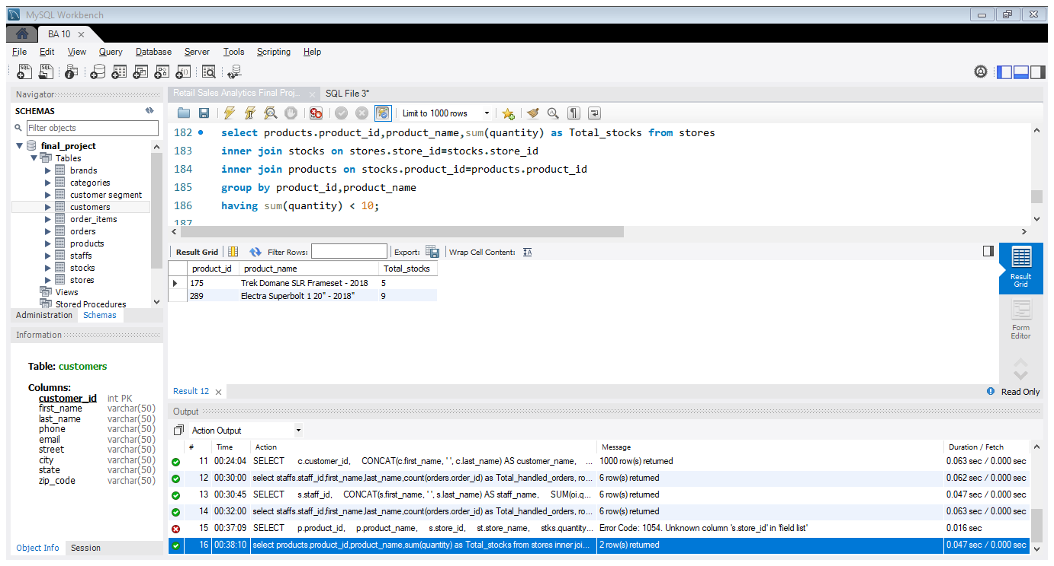
9. Stock Alert Query
Out of 321 products, only 2 products have less than 10 quantity of stocks overall.
Business Impact:
If these are high-demand products, sales may be lost due to stockouts.
If suppliers take time to deliver, urgent reorder placement is required.

Slide 17
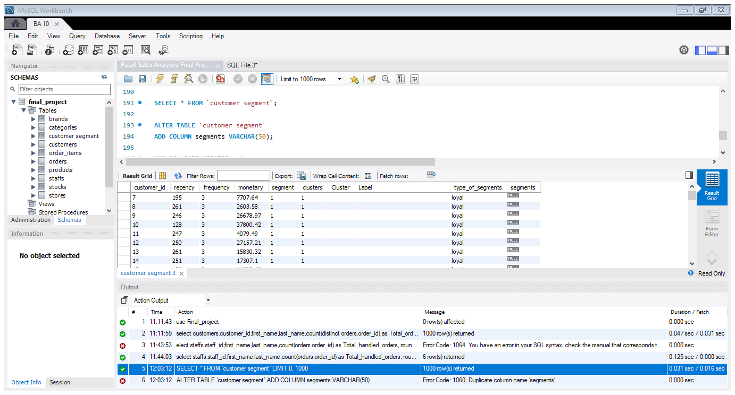
Segments | Type of Segments
0 | At-risk
1 | Loyal
2 | New
3 | Need attention
10.Create Final Segmentation Table
Focus on Loyal Customers → Keep them happy, as they drive most revenue.
Recover At-Risk Customers → They can bring additional revenue if re-engaged.
Grow New Customers → Guide them toward becoming loyal.
Monitor Need Attention Group → They can either grow into loyal or slip into at-risk.

Slide 18

Power BI – Visualization & Dashboarding

Slide 19
Power BI – Visualization & Dashboarding
1. Connect Power BI to SQL
All the dataset tables have been imported from SQL to Power BI by providing the server host number and the database name.
Data types have been verified and updated accordingly.
2. Create Relationships Between Tables
Relationships are built on common columns containing matching values between tables.
The model view snapshot with one/many relationship cardinality and cross-filter direction with single/both has been mapped accordingly.

Slide 20
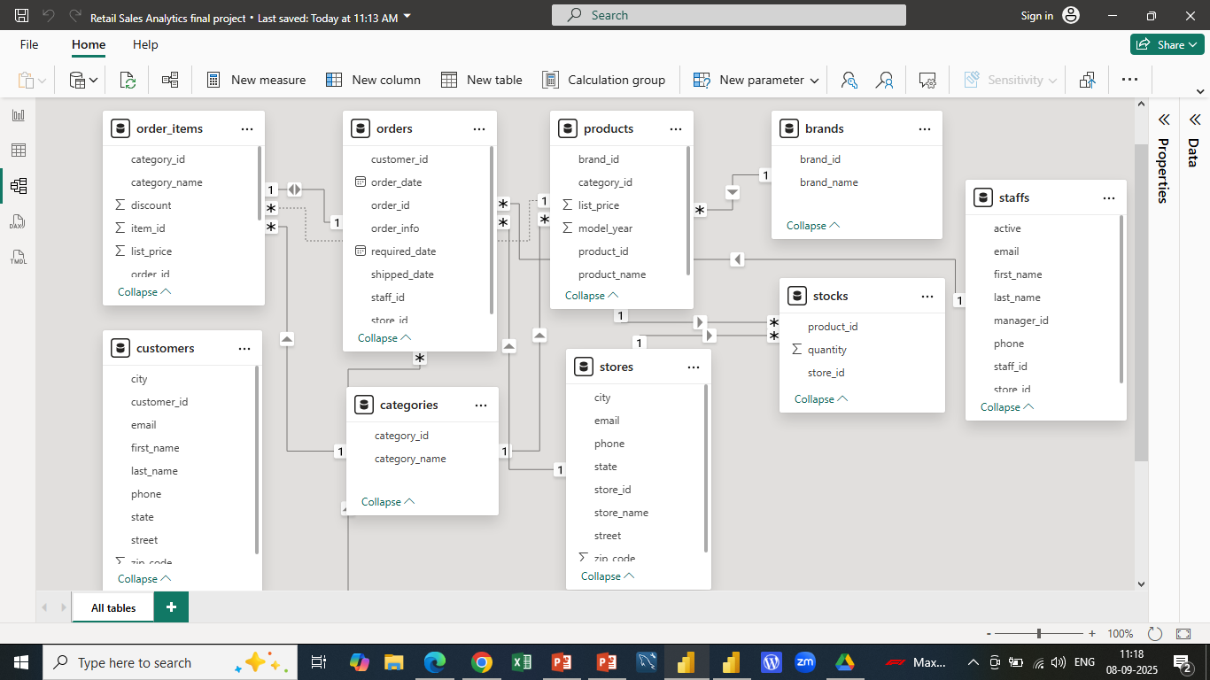

Slide 21
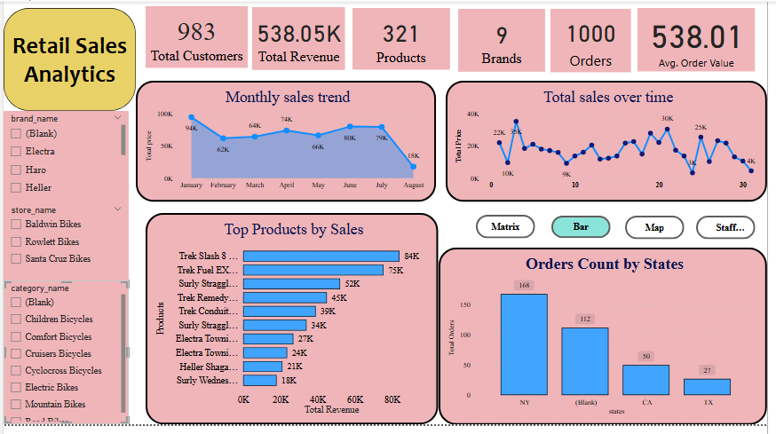
Power BI – Visualization & Dashboarding

Slide 22
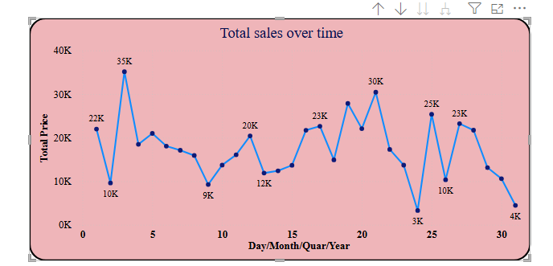

3. Sales Overview Report
3(a). Sales over Time
The highest peak occurs around day 3 (35K) and another around day 20 (30K), showing periods of strong demand.
The lowest point is near day 24 (3K), highlighting a sharp drop in sales.
Sales show high fluctuations instead of a stable trend.

Slide 23
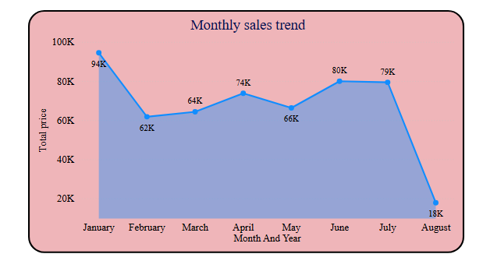
3(b).Monthly Sales Trend
The highest sales in terms of revenue happened during the month of January (94K), then dropped in February (62K).
A sharp decline appears in August (18K), the lowest point, indicating either seasonal slowdown or external factors affecting sales.

Slide 24
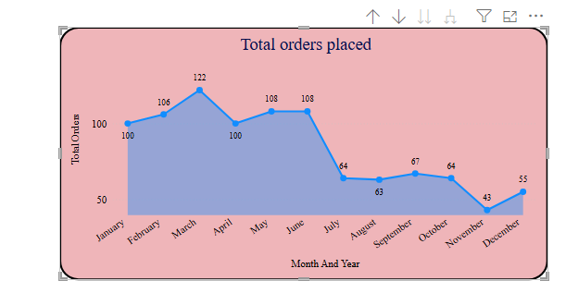
3(c).Total orders placed
The highest number of orders was placed in March (122 orders), showing peak customer activity.
The lowest point occurs in November (43 orders), showing a significant slowdown.
A small recovery is visible in December (55 orders), likely due to festive season demand.

Slide 25
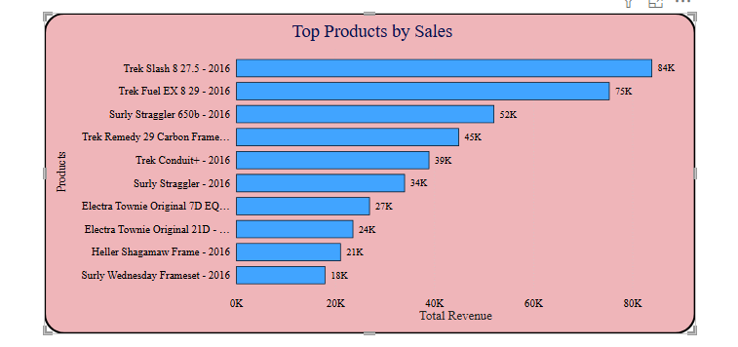
4. Top Products by Sales
The top selling product in terms of revenue is Trek Slash 8 27.5-2016 which is of 84k.
Products like Surly Wednesday Frameset (18K) and Heller Shagamaw Frame (21K) are the lowest contributors.
Mid-range performers include Surly Straggler 650b (52K) and Trek Remedy 29 Carbon (45K), showing strong but not top-tier sales.

Slide 26
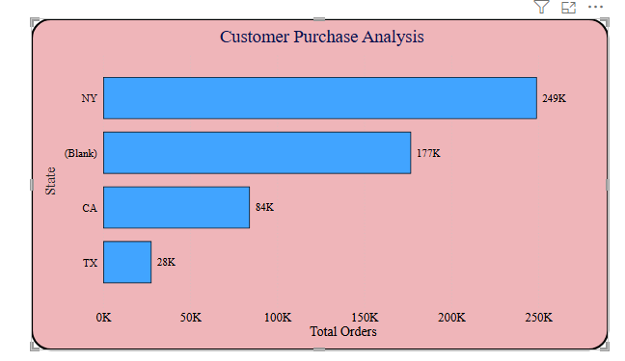
5. Customer Purchase Analysis
The highest number of orders placed by the customers in the City named Mount Vernon and Scarsdale of 20 orders being the most.
These both cities belong to the state NY.
The least number of orders also placed from the same state NY with 3 different cities which is 1 order from each city. Middle Village, Tonawanda and Westbury are the cities

Slide 27
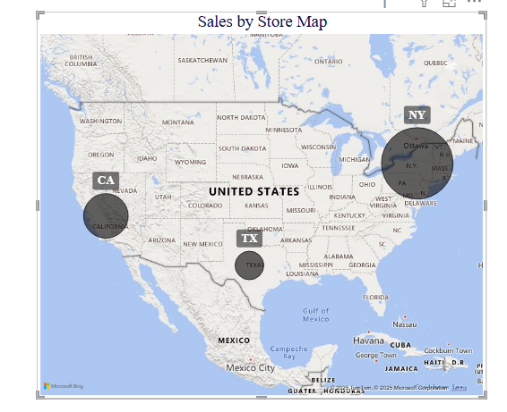
6. Sales by Store Map
Top Performing Store:
(NY) has the largest bubble on the map, meaning it generates the highest sales revenue.
Second Strongest Market:
(CA) shows the next largest bubble, indicating it is the second-highest revenue contributor.
(TX) has a medium-sized bubble, showing it contributes a moderate share of sales compared to NY and CA.

Slide 28
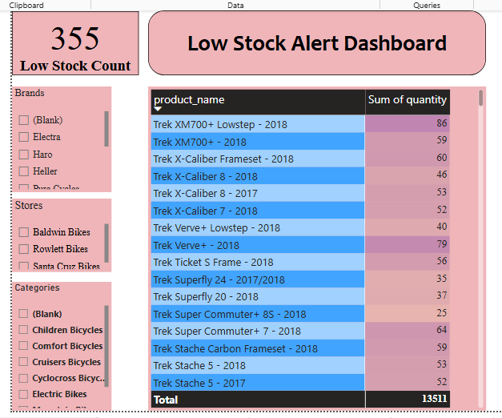
7. Low Stock Alert Dashboard
There are 355 products overall has a stock of <= 10 units. This is the count of each products in each stores overall. The same products would have been repeated in this count in different stores separately.
By merging the stocks of each products in all the 3 stores, it has been found that there are 3 products which has a stock of <= 10 units

Slide 29
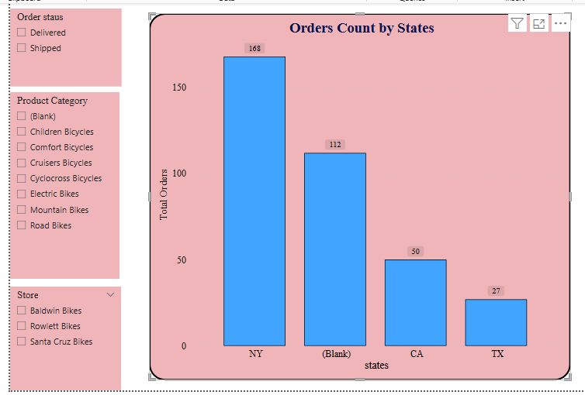
8. Interactive Filters and Slicers
This data shows the number of orders placed by each state where we could found that NY state has highest orders placed of 168 Followed by CA state with 112 and TX with 27 orders.
The interactive slicers has been created to filter through the order status, stores and Product categories in the Power BI

Slide 30
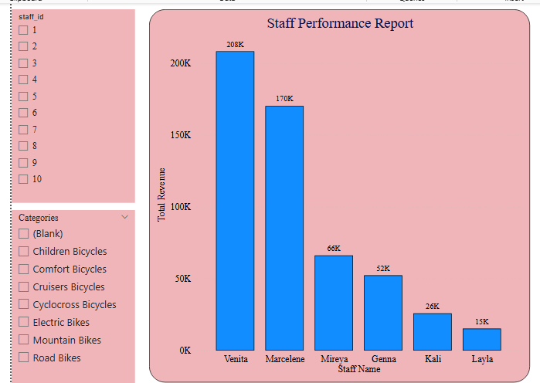
9. Staff Performance Report
The highest revenue generated by the Staffs is Staff Id 7 with 208k followed by Staff Id 6 with 170k.
The least revenue generated by the Staff Id 9 with 15k.
Staff IDs 2,3,8 and 10 have not handled any orders or generated any revenue.

Slide 31
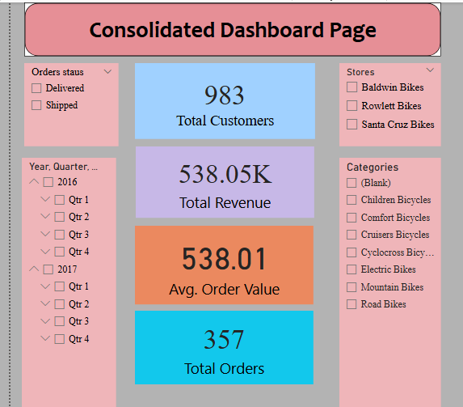
10.Consolidated Dashboard Page
The final consolidated dashboard page with KPI fields have been created.
There are 983 active customers with the total revenue generated of 538.05K where their overall average order value is 538.01K for total orders of 357.
The slicers created with order status, date, stores and categories to filter the data and to apply the KPI field values based on the requirement.

Slide 32

THANK YOU
Shalini
sunvikar02@gmail.com

